Slide 1

Codeclan Website Performance Project Brief
Andrew, Debbie, Jack & Nick

Slide 2
Project Brief
Project summary
To help CodeClan marketing Killian McAleese funnel information, breakdown and identify which advert are working on which social media platforms people use to come the CodeClan website.
Target audience
To allow allow the CodeClan marketing department be able to quickly, simply and easily illustrate to exec eg Melinda Matthews without having additional information which could be distracting additional information/ noise.
Problem
We would like to better understand how CodeClan’s website users are navigating the site, with a focus on driving visitors to sign up for events and information sessions.
The website sees roughly 9000 visitors per month. However, only a small number of these visitors - about 100 per month - use the website book an event.
We would like to understand:
The journey users take
How they arrive on the site
Where they drop off?

Slide 3
Are there any problems with the journey and is there anything we can do to support event bookings?
Can we increase event booking to 200 per month? If so, what changes would be recommended and how could these be monitored?
Goal
As a group create a dashboard that:
Extracts data from CodeClan’s Google Analytics account
Displays relevant data clearly
Is designed to address the business problem
Enables the user to see what is happening at a glance
Is supported by documentation that contains definitions and assumption
KPI
Simplicity is key
Assumptions
Dates - March 2020- present
A side by side graphic comparison might be helpful
Timeline

Slide 4
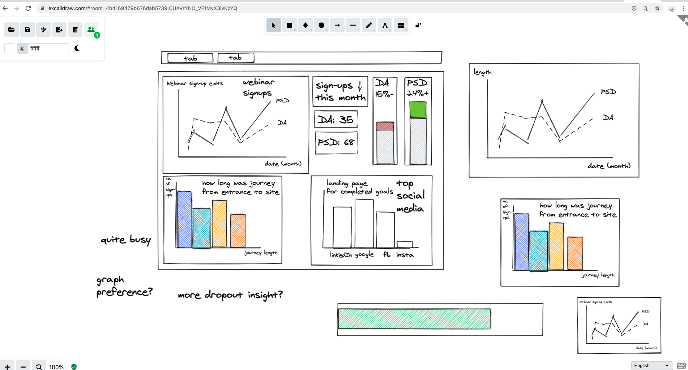
Notes:
We animated the plan of what we thought would be best to have on the app

Slide 5
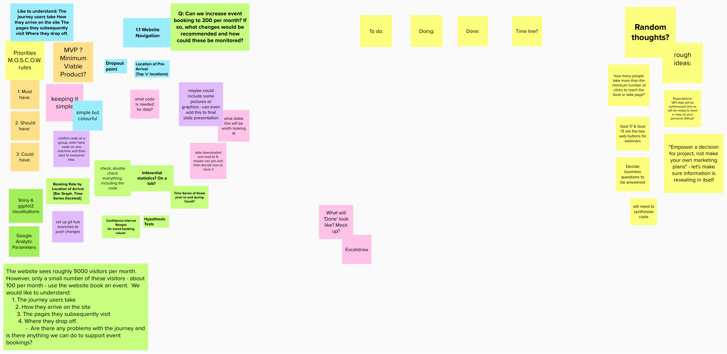
Project planning- MURAL

